Slide 1


Buscar
APACHE STRUTS

Slide 2
www.Members.com
Buscar
Humaran Beltran Saul Alejandro
Chino Rojas Edwin Fernando
Felix Verdugo Jose Javier

Slide 3
www.intro.com
Buscar
Introduction

Slide 4
www.What Is Apache Struts?
Buscar
Apache Struts 1 is an open-source framework used for developing web applications in Java..

Slide 5
www.How it Works.com
Buscar
Struts 1 works by intercepting incoming requests and routing them to appropriate Action classes.

Slide 6
www.Advantages.com
Buscar
Modularity:
Reusability:
Customization:
Validation:

Slide 7
www.Disadvantages.com
Buscar
Steep Learning Curve:
Outdated:
Boilerplate Code:

Slide 8
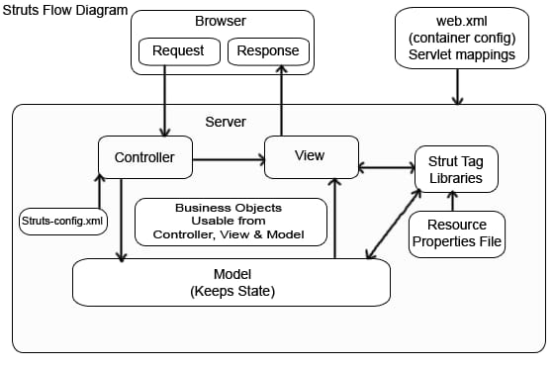
www.Architecture.com
Controller
Model:
View:
Struts
Configuration Files:

Slide 9
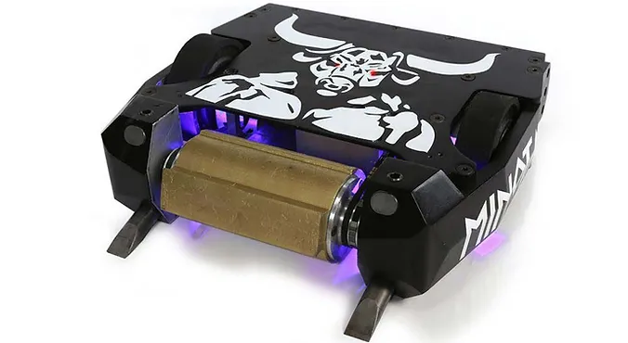
www.Proyects_Examples.com
Buscar
Riobotz Combat Robot:

Slide 10

www.Proyects_Examples.com
Buscar
Apache OFBiz:

Slide 11

www.Proyects_Examples.com
Buscar
OpenMRS:

